Slide 1
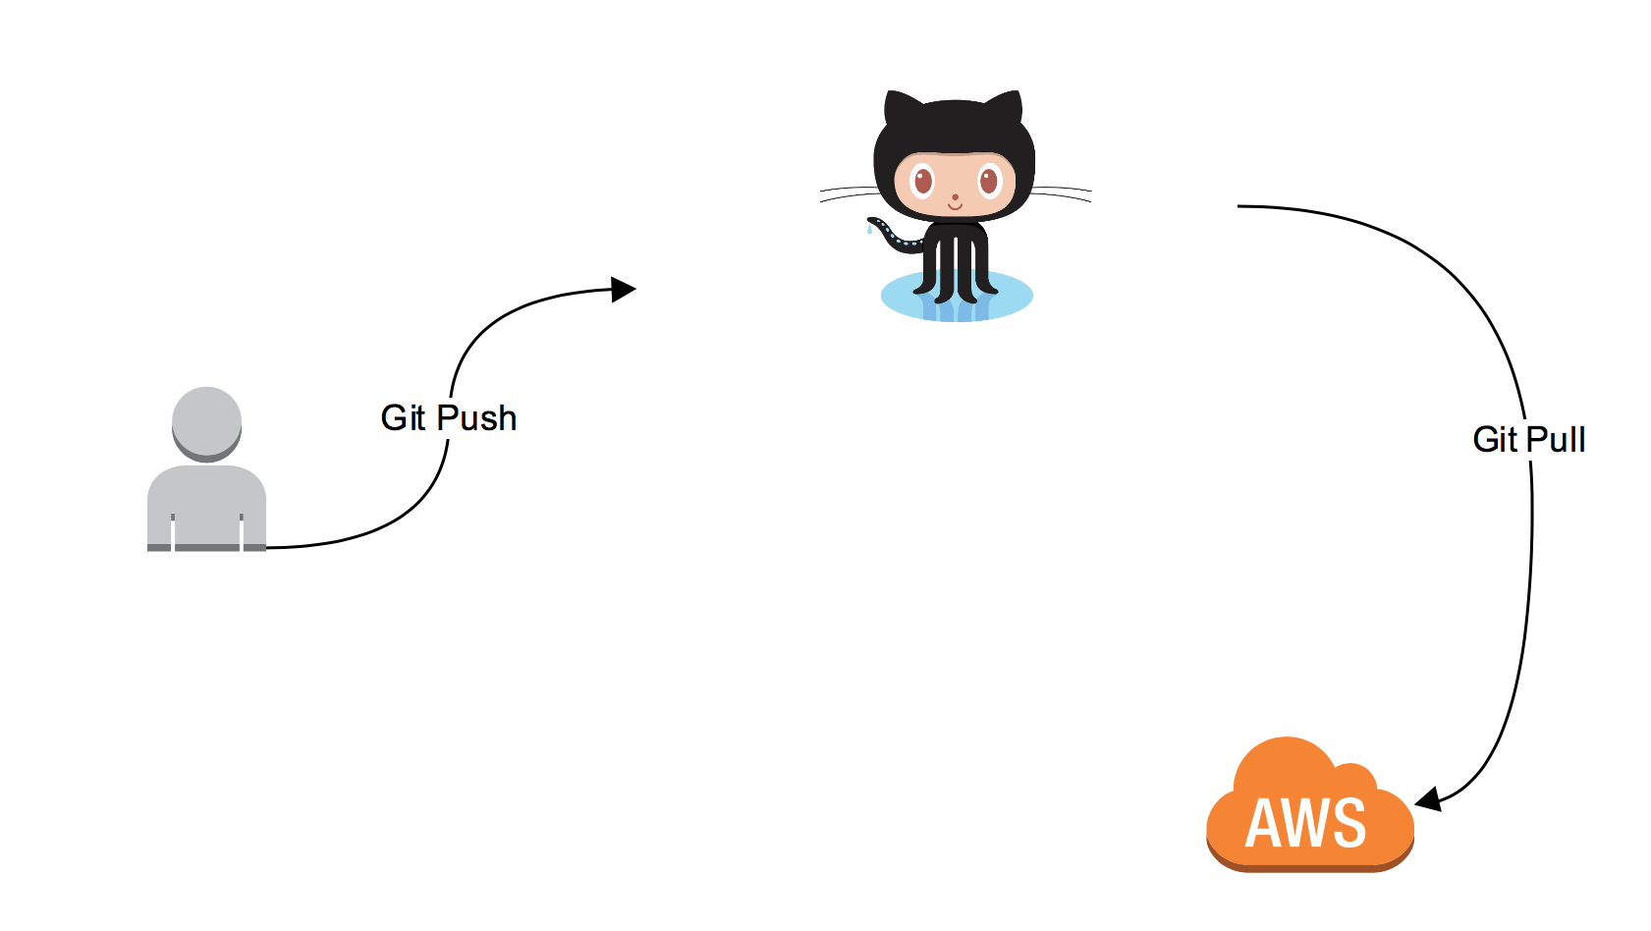
Basic Work Flow ( Simplified )

Slide 2
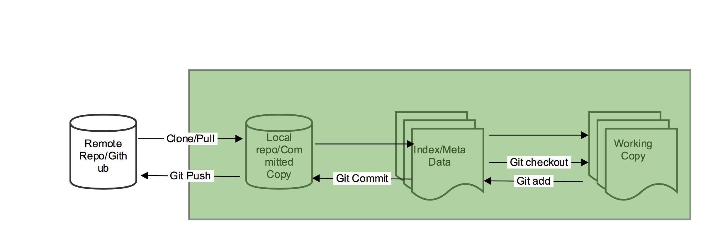
Git Work Flow

Slide 3
Working Example
git clone git@github.com:kchandan/devopstraining.git
cd devopstraining
<Do some changes>
touch <Yourname>
git add <yourname>
git commit -m ‘Added my file’
git push origin master

Slide 4
Incremental Changes
On Local box
git add
git status
git commit
git push
On AWS
git clone
git pull

Slide 5
Branching
All commits in git live on some branch
But there can be many, many branches
The main branch in a project is called the master branch

Slide 6
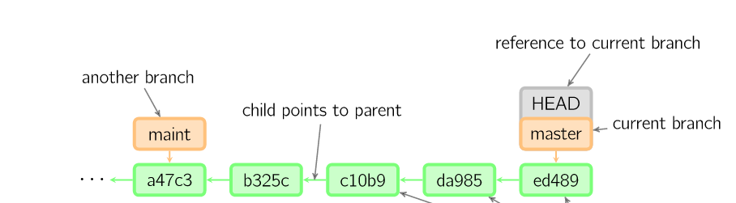

Commit life cycle
Time going forward

Slide 7
HEAD of the commit
A reference to the most recent commit
Time going forward

Slide 8
Branching Off
The start of a branch points to a specific commit
When you want to make any changes to your project you make a new branch based on a commit

Slide 9
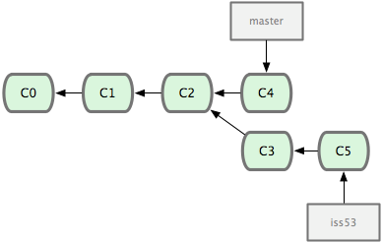
Branching off Master
Time going forward

Slide 10
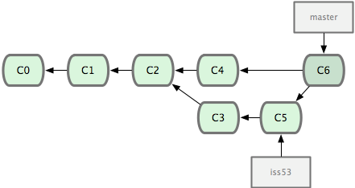

Merging
Time going forward

Slide 11
Branch Conflict
When same file has been modified by two users
Merging could cause conflict
Conflicts need to be resolved Manually
Demo

Slide 12
Group Excercise
Create a branch with your name into local repo on devopstraining repo
Create a branch
Write a bash program to print hostname and IP address of the system called genreport.sh under devopstraining/bash folder.
Push the branch to Github
Create Pull request and make someone else reviewer to merge your branch changes into master

Slide 13
Quick Recap
Command | Usage
Git log | Check the history of the whole repo
Git add | Add the file into staging area
Git commit | Commit the file to local repo
Git push | Push to remote repo
Git blame <file-name> | Find the history of changes done on that file
Git status | Checking current staging area
Git checkout –b <branch> | Create a new branch off existing branch
Git merge <branch name> | Merge the branch with existing
Git reset | Reset all changes
Git stash | Stash changes to local staging area
Git pull | Pull from remote to local

Slide 14
Git Work Flow

Slide 15
Forking a Repo
Creating another copy of the repository.
Forking a repository allows you to freely experiment with changes without affecting the original project.
Allows you to experiment without impacting the main repo
After fork you become owner of the repository

Slide 16
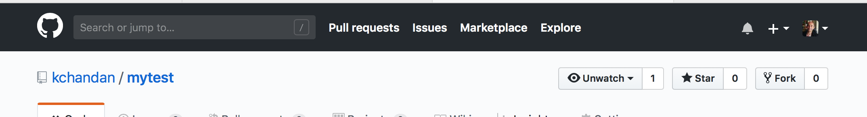
Forking is easy – Step 1
https://github.com/kchandan/bash
Click on the Fork Icon

Slide 17
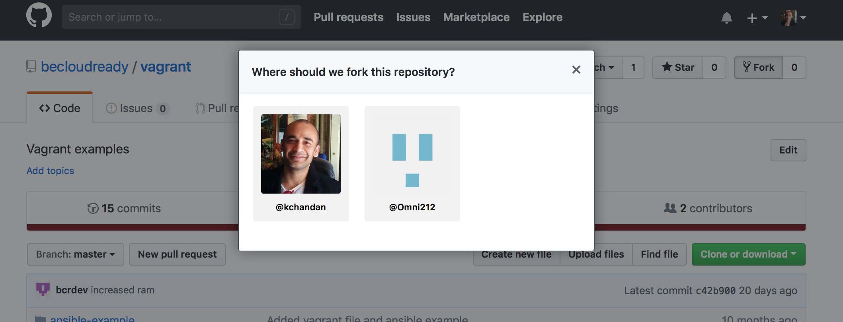
Forking Step 2
Select your github profile where you want to fork it.

